Slide 1
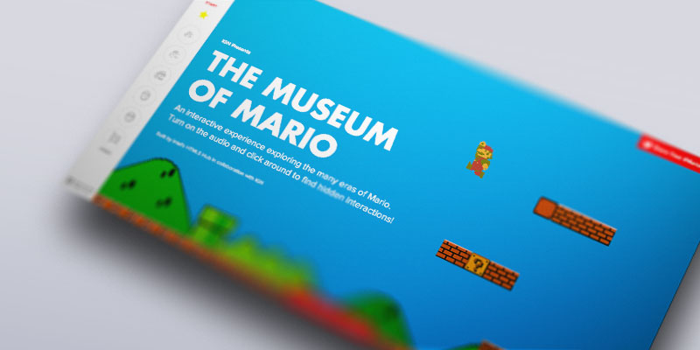
Museum of Mario: Intel & IGN Entertainment
The Challenge
Results
Banyan Branch, an advanced digital marketing studio, partnered with Affirma to work on an exciting project for Intel and IGN Entertainment. Intel and IGN wanted to develop a custom interactive website with responsive design that would feature the history of Mario for their Museum of Mario project. The venture was designed to promote Intel and IGN by showcasing a number of new web technologies such as HTML5, CSS3, and 3D mechanics. IGN gave us the artwork and sounds along with a brief description of a desired finished product. We were challenged to put all of the assets together and give it creative flair.
The site was successfully launched on the main IGN website as well as Intel and IGN's promotional site, html5hub.com. The client was very happy with the work and continually increased the scope of Affirma's involvement throughout the project. The project also gave us new experience with the latest animation techniques, new plug-ins, and paralaxing JavaScript.
What We Did
Utilized HTML5 and CSS3 within their JavaScript structure to build the pages and brought the separate pieces together for parallax viewing with responsive design.
Added our own creative elements to the assets and descriptions given to us by IGN.
Ensured a smooth final launch by troubleshooting and bug fixing each page of the site.
Fully developed the Super Mario Brother 1, Mario Kart, Mario Brothers Wii and Wii U, and Super Mario 3D Land and World pages.

